Slide 1
Ray Tracing in Python
Ansh Desai
Stony Brook University

Slide 2
What is a ray tracer?
Ray tracing is a general term used to describe any technique used for modeling light rays interacting with an environment
Capable of simulating a variety of optical effects (reflection, refraction, shadows, scattering, depth of field, motion blur)
The process of generating an image is known as rendering
Traditionally rendering is slow and is used for computer generated images or VFX rather than video games (this has been changing)

Slide 3
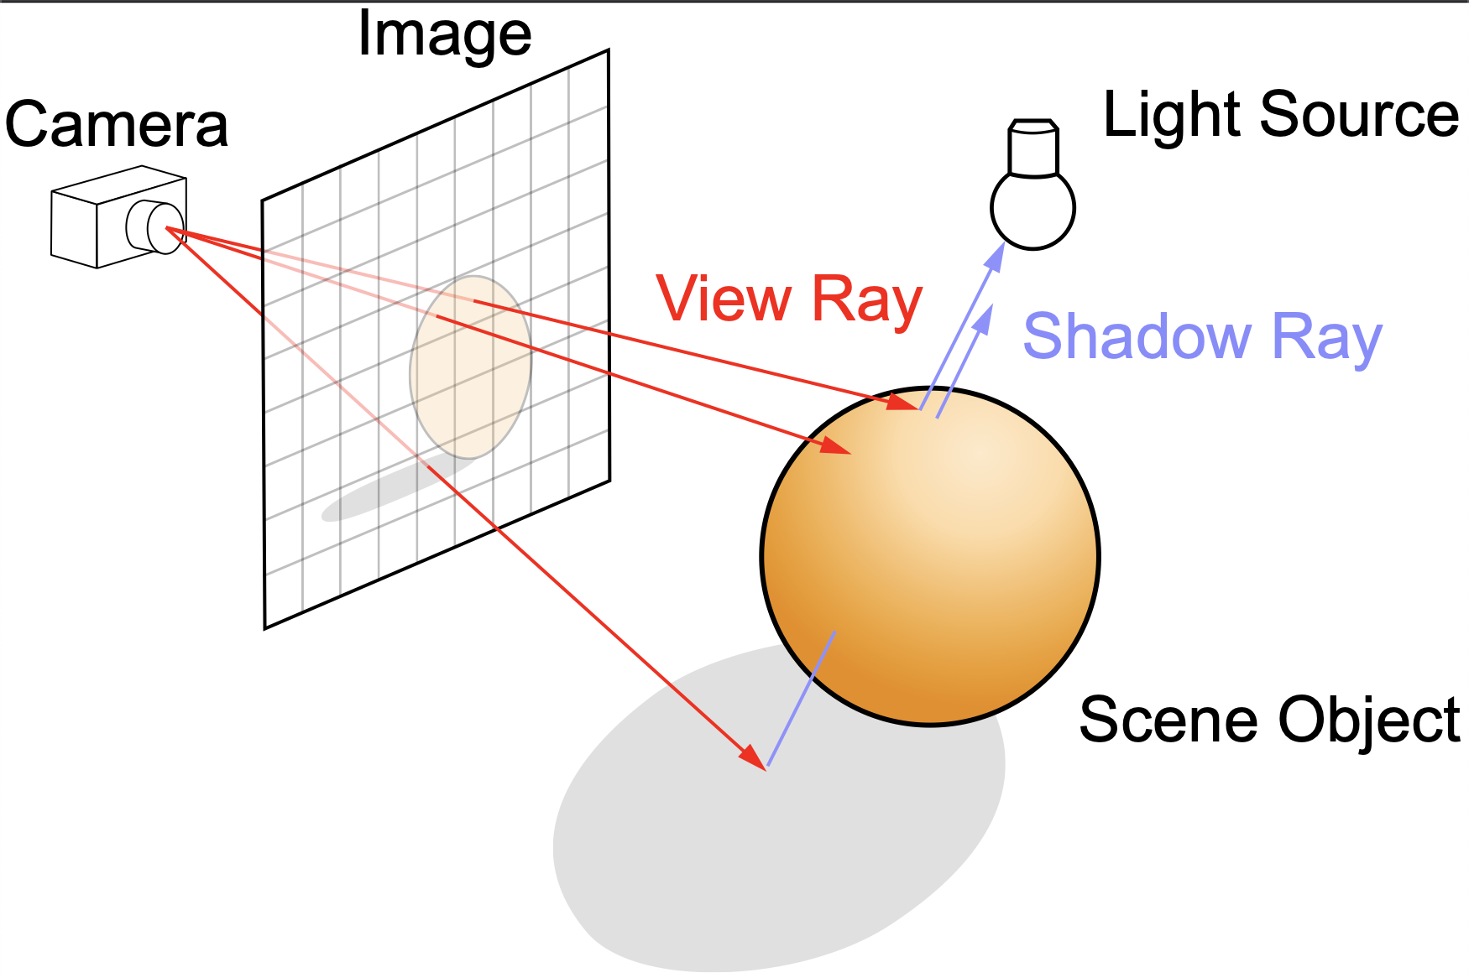
General Algorithm Overview
Trace a path from an imaginary eye through each pixel in an image
Calculate color of the pixel as it interacts with objects of different materials
Light sources are modifiable
3D Environment is projected onto 2D Image
By Henrik - Own work, CC BY-SA 4.0, https://commons.wikimedia.org/w/index.php?curid=3869326

Slide 4
Basics of the code
Outputs image as a ppm file on a pixel by pixel basis
Two functions for the writing of the image:
ray_color: a function that sends a specified number of rays at each pixel to model the interaction, and returns a color vector,
write_color: which gamma corrects and outputs the rgb values as a string so it can be output into a file
Rest of the code is divided up into classes for organization and consistency
Classes used: ‘objects’ ‘materials’ ‘textures’ ‘ray’

Slide 5
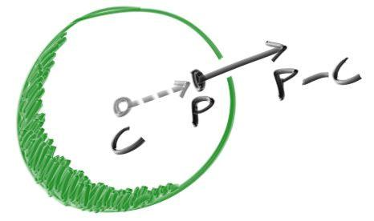
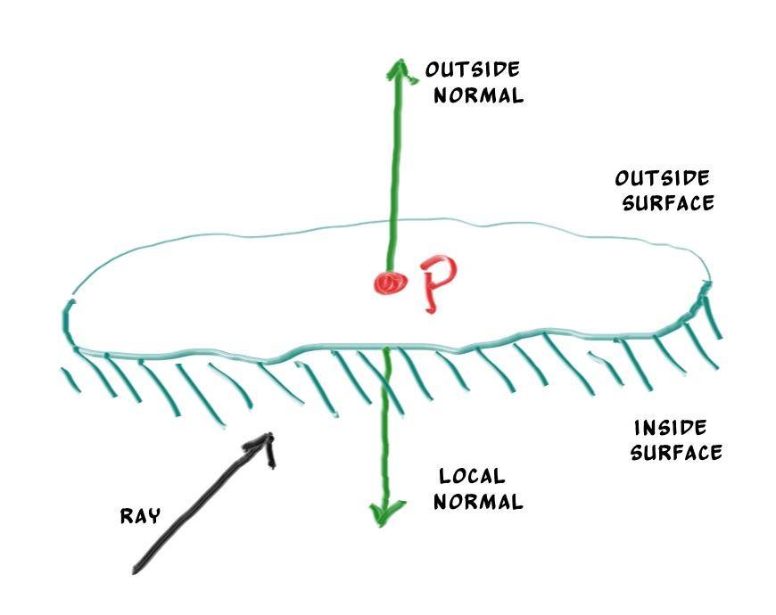
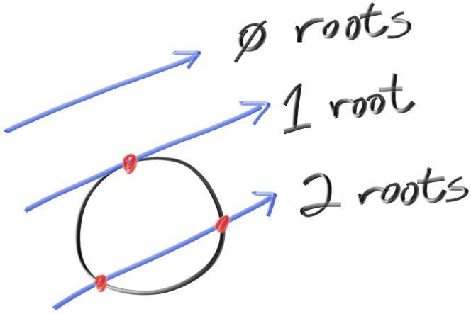
First Object: A Sphere
Surface normals of a sphere are important to calculate so shading can be modeled
Sphere-ray interactions are straightforward to calculate

Slide 6
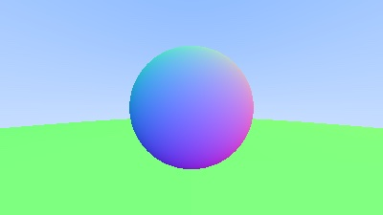
Basic Image Output
Here is a sphere with shaded surface normals, a gradient background acting as the sky and a large green sphere acting as the ground

Slide 7
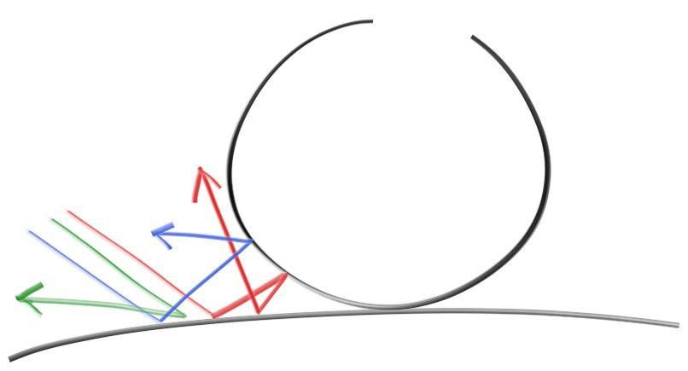
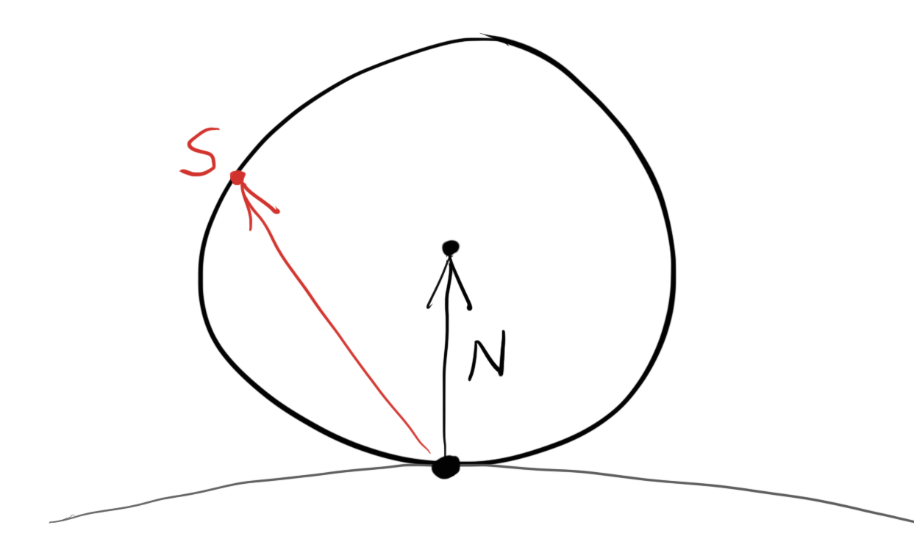
Diffuse Materials
Diffuse objects modulate light with own intrinsic color
Light rays can either reflect in random directions or be absorbed
Darker the material the more likely absorption is
Light rays will scatter randomly
Generating a random unit vector to see where ray goes

Slide 8
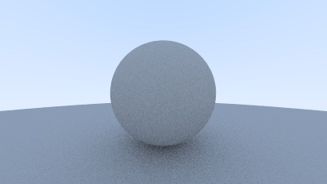
A Diffuse Sphere

Slide 9
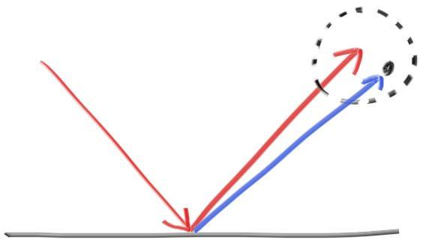
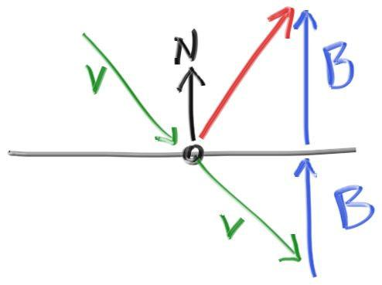
Consider Metal instead of Diffuse Material
Now rays don’t scatter randomly, they reflect
Can include a ‘fuzziness’ parameter for reflections that aren’t perfect

Slide 10
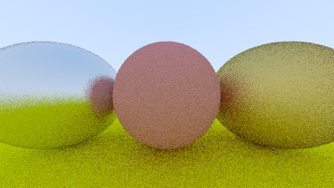
Metal Spheres with Fuzz

Slide 11
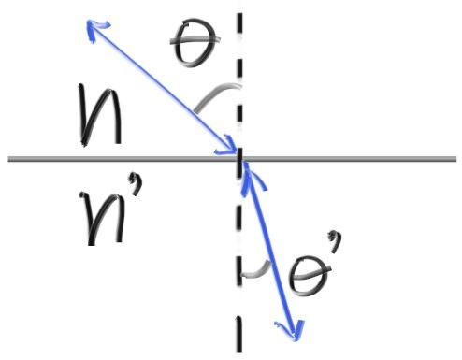
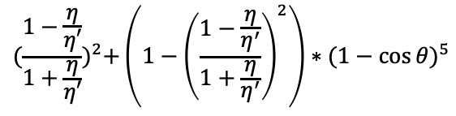
Dielectrics
Now model refraction using dielectrics
When light rays hit dielectrics, they split into a reflected ray and a refracted ray
This implementation simplifies it by randomly choosing whether the ray reflects or refracts
Refracted rays are modeled by Snell’s Law:
𝜂sin(𝜃) = 𝜂’sin(𝜃’)
If solution does not exist, glass cannot refract
Real glass has reflectivity that varies with angle:
Schlick approximation works really well
$${(\frac{1−\frac{η}{η′}}{1+\frac{η}{η′}})}^{2}+\left(1−{\left(\frac{1−\frac{η}{η^{′}}}{1+\frac{η}{η^{′}}}\right)}^{2}\right)∗{(1−\cos{θ})}^{5}$$

Slide 12
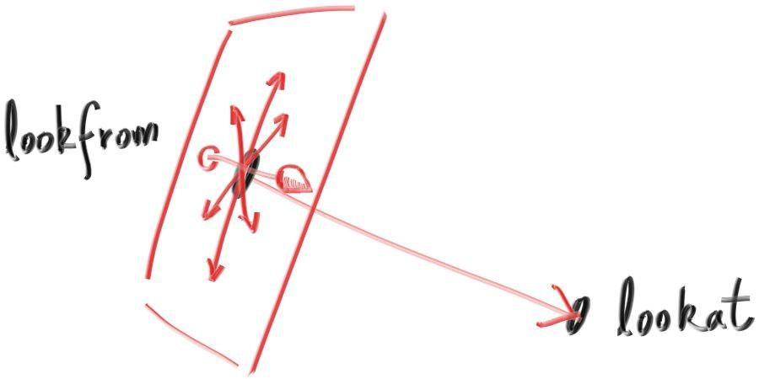
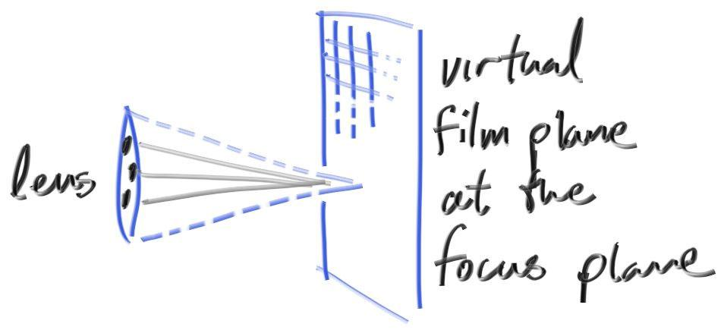
The Camera
Can modify parameters of where image is viewed from
Field of view
Aspect ratio
A “lookfrom” point
A “lookat” point
An orientation
Thin lens approximation to create depth of field

Slide 13
Playing Around
The design architecture is flexible and allows for many modifications
Things I messed with:
different sources of lighting
Objects of different shapes
Various textures
Increasing speed of render
probability density functions to model different scattering
Sampling more of the light source to reduce noise

Slide 14
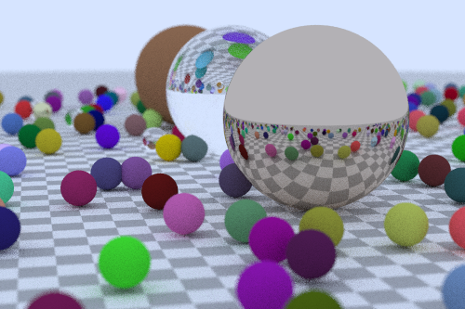
Spheres

Slide 15
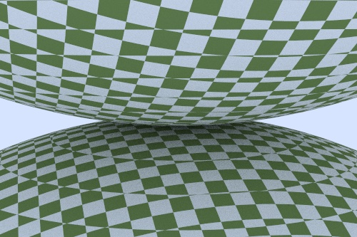
Checkered Spheres

Slide 16
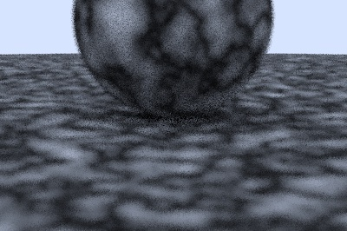
Random Noise Texture (“Turbulence”)

Slide 17
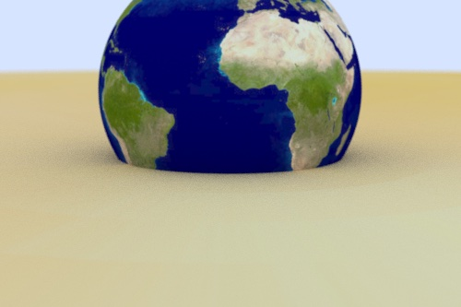
Images as Textures

Slide 18
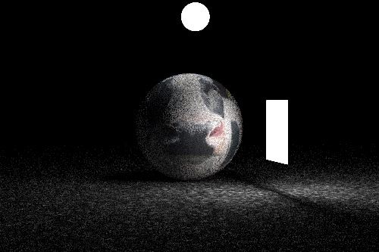
Interior Lighting

Slide 19
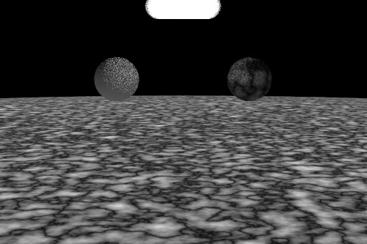

Slide 20
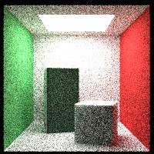
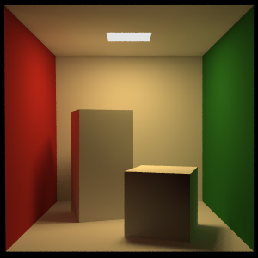
The Cornell Box

Slide 21
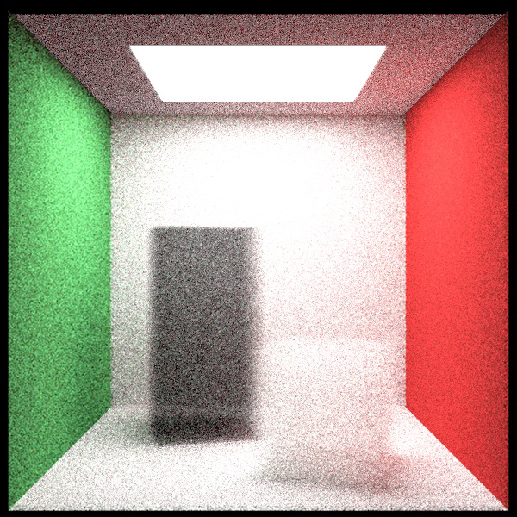
The Cornell Box with Boxes made of Smoke

Slide 22
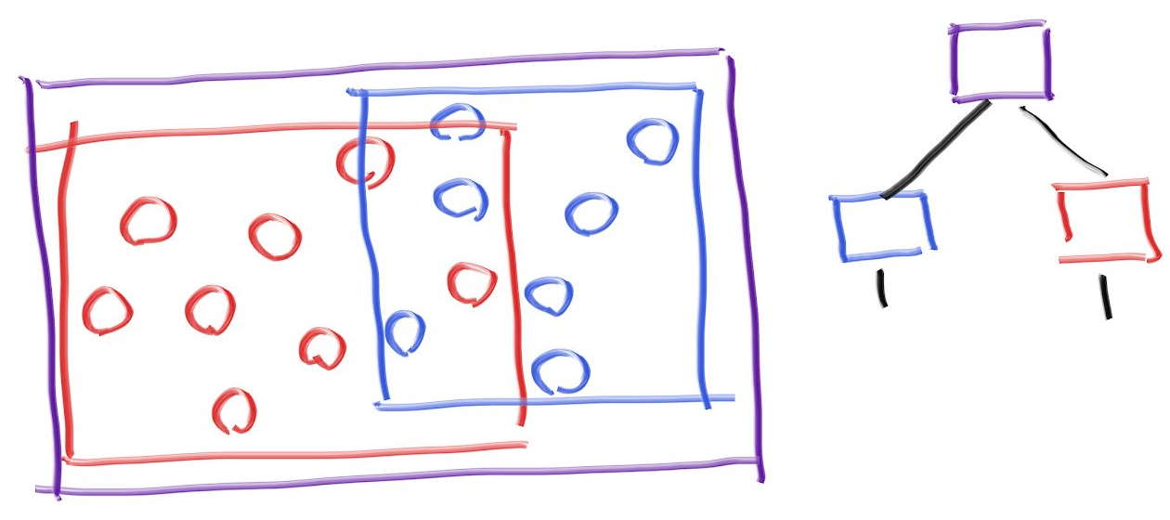
BVH Architecture
What i previously described is a brute force method: very slow
Can improve speed with boundary box and node architecture
Ray object intersection is the major time sink, but it’s a repeated search on the same model
Calculate whether ray intersects
with bounding volumes to reduce
search time

Slide 23
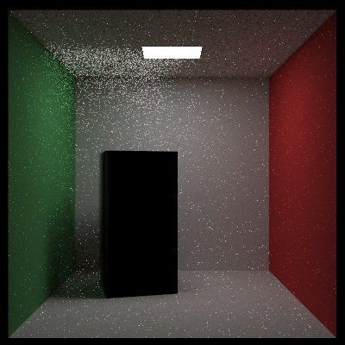
Current Work: Noise Reduction with Probability Density Functions
Modify how light scatters off materials
Sample more of the source of light to try to reduce noise
Modify light source so that light is only emitted downwards
Noise in upper part of this image are places that were not sampled as much as the rest

Slide 24
Discussion/Conclusion
Mathematical accuracy is hard to determine, but it serves as a good model for how light interacts with objects
I played around with reproducing models from the books I was reading as well as creating my own
Theoretically this method could be used to approximate any wave phenomena with approximate linear motion, so it would have been interesting to map out sound waves or other linear-like physics
Would also have been interesting to create models for more complex shapes

Slide 25
References
Ray Tracing in One Weekend. raytracing.github.io/books/RayTracingInOneWeekend.html
Ray Tracing: The Next Week. raytracing.github.io/books/RayTracingTheNextWeek.html
Ray Tracing: The Rest of Your Life. raytracing.github.io/books/RayTracingTheRestOfYourLife.html

